Slide 1
INTERNSHIP TASK -3
TEMPERATURE
MONITORING
SYSTEM
KEVIN VICTOR
Intern ID : CTIS8913

Slide 2
TASK 3
USE A TEMPERATURE SENSOR TO READ AND DISPLAY TEMPERATURE DATA ON AN LCD OR SERIAL MONITOR.

Slide 3
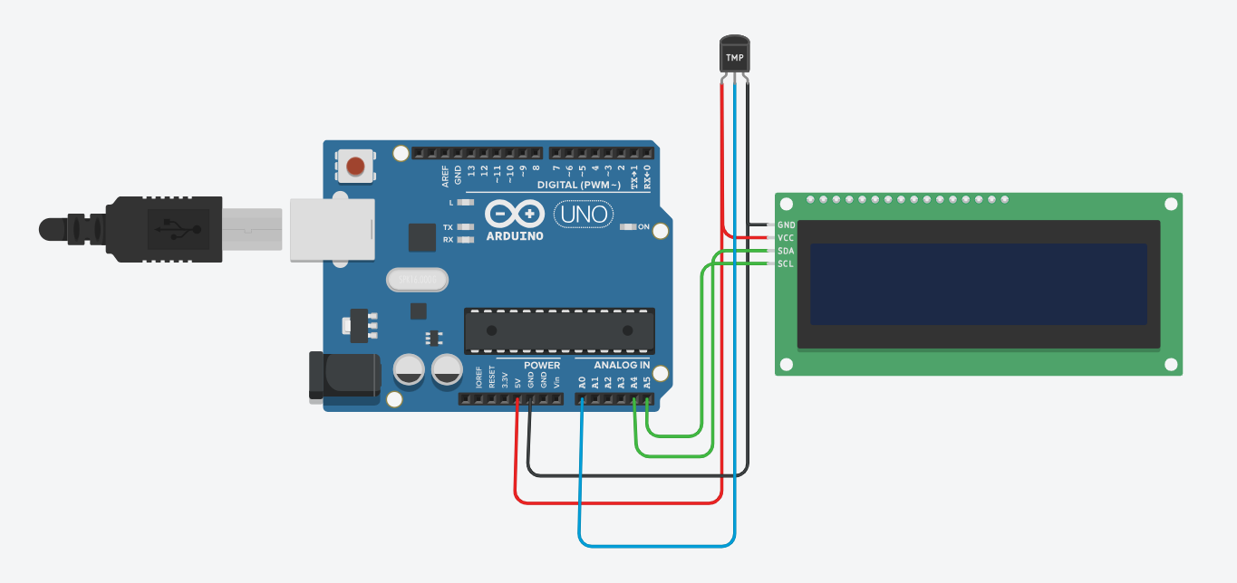
CIRCUIT DESIGN
Components
Temperature sensor - TMP36
Arduino Uno R3
lcd ( 16 X 2 )

Slide 4
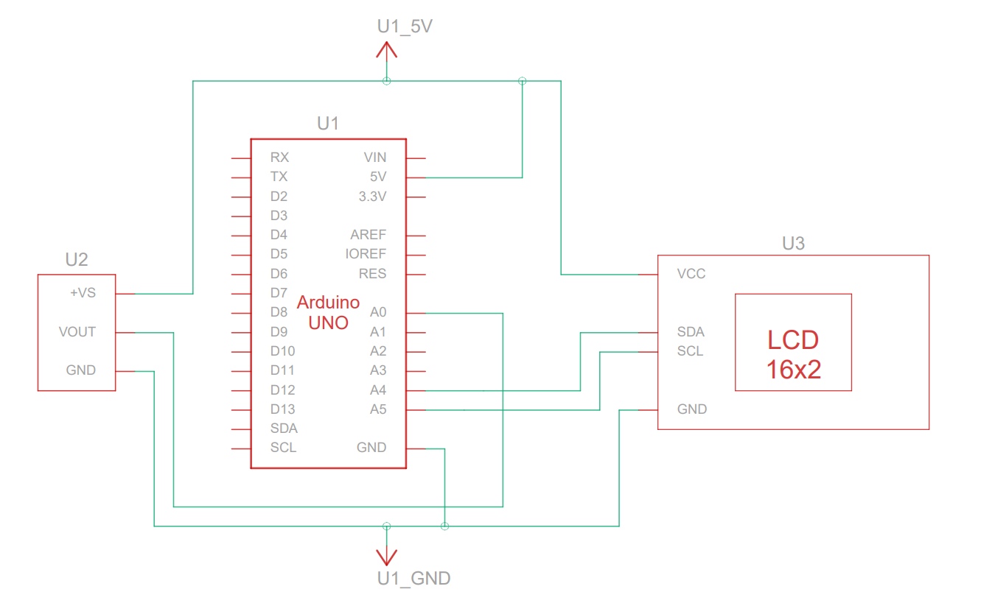
SCHEMATIC VIEW

Slide 5
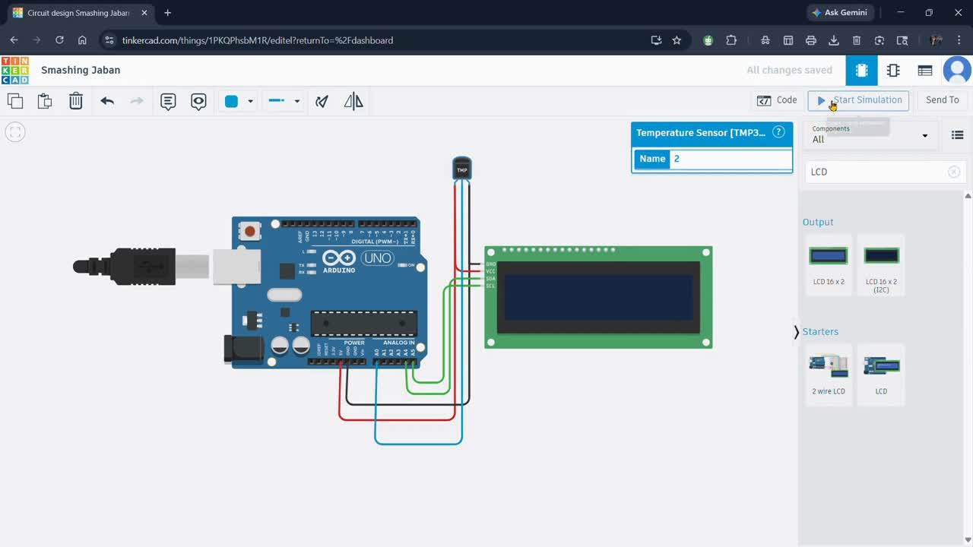
OUTPUT DEMONSTRATION

